Slide 1

STANLEY COLLEGE OF ENGINEERING AND TECHNOLGY FOR WOMEN (AUTONOMOUS)
Abids. Hyderabad – 500 001
(Affiliated to Osmania University & Approved by AICTE)
(All eligible UGC courses are accredited by NBA & NAAC with ‘A’ Grade)
Department of Computer Science and Engineering
Academic Year: 2025-2026
INTERNSHIP Presentation
Loan Eligibility and Recommendation Model
Supervised by: Dr.M.Sowmya(Associate professor)
MRS.Shadeda Begum(Assistant professor)
Department of CSE
PRESENTED BY
Basireddy Shivani
160622733074

Slide 2
Contents
Problem Statement
Background & Literature Review
Planning and Design of Work
Implementation & Execution
Testing & Validation
Results & Analysis
Challenges & Solutions
Conclusion & Future Scope
References
Internship Certificates

Slide 3

Problem Statement
Manual loan approval processes are often slow, inconsistent, and susceptible to human bias, resulting in inefficiencies and unfair outcomes.
Predictive analytics and machine learning offer powerful tools to streamline loan approvals, reduce manual workload, and minimize errors.
This project aims to build a machine learning model to:
Accurately predict loan eligibility using applicant financial and demographic data.
Recommend suitable loan options based on eligibility and user profile.

Slide 4
Background&Literature Survey
Paper Name | Author(s) | Key Findings | Relation to Our Project
Machine Learning for an Enhanced Credit Risk Analysis: A Comparative Study of Loan Approval Prediction Models Integrating Mental Health Data | A. Alagic et al. | Integrated financial and mental health data using XGBoost and Random Forest, improving accuracy of loan approval prediction. | Supports use of XGBoost for high prediction accuracy in financial risk analysis.
Loan Forecast by Using Machine Learning | A. Kulothungan et al. | Used Decision Tree and Logistic Regression for loan forecasting, achieving ~77% accuracy. | Highlights the need for data preprocessing and ML-based automation for better predictions.
Loan Default Prediction Using Decision Trees and Random Forest: A Comparative Study | M. Madaan et al. | Found Random Forest more accurate (87% recall) than Decision Tree in predicting non-defaulters. | Supports use of ensemble learning for improved accuracy and reduced overfitting.
Loan Approval Prediction Based on Machine Learning Approach | N. A. Azeez and A. O. Emmanuel | Compared Decision Tree and Random Forest for loan approvals; Random Forest showed superior results. | Validates use of classification algorithms like Random Forest in loan eligibility systems.
A Machine Learning–Based Credit Risk Prediction Engine Using a Stacked Classifier | E. Ileberi | Proposed a stacked ensemble model improving credit risk prediction accuracy and efficiency. | Encourages use of ensemble and stacked models for robust prediction.

Slide 5
Background&Literature Survey
Data-Driven Loan Default Prediction: A Machine Learning Approach | Systems Editorial Board | Implemented data-driven ML techniques to achieve >90% accuracy in default prediction. | Reinforces importance of data preprocessing and parameter tuning.
Machine Learning for Credit Risk Prediction: A Systematic Literature Review | R. Rahman et al. | Reviewed ML algorithms for credit risk; highlighted XGBoost and Random Forest as most reliable. | Confirms that XGBoost is widely adopted for financial classification tasks.
A Secure Bank Loan Prediction System by Bridging Differential Privacy | J. Zhang et al. | Focused on data privacy while predicting loan approvals using ML. | Emphasizes importance of data security and privacy in financial ML models.
Credit Risk Prediction Using Machine Learning and Deep Learning | M. Patel et al. | Compared ML and DL models; found ML models faster and equally accurate for credit risk prediction. | Justifies use of ML (XGBoost) over complex DL models for efficiency.
An Ensemble Machine Learning–Based Bank Loan Approval Prediction System | K. Bansal et al. | Developed ensemble ML system achieving 93% accuracy for loan approval prediction. | Directly aligns with our loan eligibility model using ensemble algorithms.

Slide 6
Planning And Design Of Work
Week | Task Overview | Tools / Technologies
1 | - Understood loan eligibility problem and project scope. - Conducted domain research on credit scoring and predictive analytics. - Set up Python environment and version control system. - Installed key libraries and prepared project plan. | Python, VSCode, Git/GitHub
2 | - Generated synthetic loan applicant data to simulate real-world scenarios. - Preprocessed data: cleansing, encoding categorical features, feature engineering. - Performed exploratory data analysis to identify patterns affecting loan approval. | pandas, numpy, scikit-learn, matplotlib, seaborn
3 | - Developed and fine-tuned machine learning models including advanced XGBoost classifier. - Implemented hyperparameter tuning via grid search and cross-validation. - Evaluated models using multiple metrics including accuracy, precision, recall, F1-score, and ROC-AUC. - Saved trained models and preprocessing pipelines for deployment. | scikit-learn, XGBoost, joblib, Jupyter Notebook
4 | - Integrated the trained model into a user-friendly Streamlit app for real-time loan eligibility prediction. - Added dynamic bank loan offer recommendation feature based on synthetic/generated offers. - Enhanced UI with interactive visualizations and charts. - Conducted user testing and finalized documentation and deployment processes. | Streamlit, matplotlib, plotly, Python, joblib, Git

Slide 7
Implementation & Execution
The loan eligibility prediction system was developed using a combination of advanced data science techniques and modern application frameworks.
TECH STACK:
Programming Language: Python 3.x, chosen for its rich ecosystem in machine learning and data analysis.
Data Science Tools:
Libraries: pandas, NumPy for data manipulation; scikit-learn and XGBoost for model training and evaluation.
Hyperparameter Tuning: GridSearchCV implemented for optimizing model parameters.
Data Visualization: plotly and matplotlib for interactive visualizations in the app and reports.
Application Framework: Streamlit for rapid UI development and deployment of the interactive loan eligibility dashboard.
Model Persistence: joblib used to serialize and load the trained model, scaler, and encoders for consistent preprocessing and predictions.
Environment & Dependency Management: All dependencies managed and installed via requirements.txt.

Slide 8
Process flow
Synthetic Dataset Generation: Developed a comprehensive synthetic dataset with 8,000 records representing diverse user profiles. The data included demographic, financial, and behavioral variables critical for assessing loan eligibility.
Feature Engineering and Data Preprocessing: Created derived features such as debt-to-income ratio and experience-to-age ratio to better capture financial stability and risk. Applied label encoding for categorical variables and standardized numerical features to ensure consistency.
Model Training and Optimization: Trained an XGBoost classifier, performing extensive hyperparameter tuning with GridSearchCV and cross-validation to maximize predictive accuracy and generalization on unseen data.
Model Evaluation: Assessed the model using multiple evaluation metrics including accuracy, precision, recall, F1-score, and ROC-AUC. Performed detailed confusion matrix analysis to interpret classification outcomes and refine decision thresholds.
Application Development and Deployment: Integrated the trained model into an interactive Streamlit application, enabling real-time loan eligibility prediction, dynamic loan recommendations, and automated EMI calculations through a user-friendly interface.

Slide 9
Testing And Validation
Functional Testing: Verified validity and range of user inputs such as CIBIL score, income, loan amount, and EMI to ensure input correctness and display of appropriate error messages. Confirmed that loan eligibility predictions, EMI calculations, and bank recommendation logic functioned accurately across different user scenarios.
Model Validation: Employed an 80-20 train-test split to evaluate model performance using metrics like accuracy (90.8%), precision (88.4%), recall (87.9%), and F1 score (88.1%). Analyzed confusion matrix results to assess the model’s classification capability and identify areas for fine-tuning.
User Testing: Conducted manual tests on the Streamlit interface to validate prediction response time and clarity of displayed information such as approval status and EMI breakdowns. Collected peer feedback on UI design for improved user experience, layout, and messaging clarity.
Confusion matrix analysis was used to identify true positives, false positives, and false negatives, allowing fine-tuning of decision thresholds to improve prediction accuracy and reduce misclassification errors.

Slide 10

Result & Analysis

Slide 11
Result & Analysis
Metric | Value | Interpretation
Training Accuracy | 95% | Model performs well on training data (good fit).
Testing Accuracy | 92% | Model generalizes effectively on unseen data.
Precision | 91% | 91% of approved loans were truly eligible.
Recall | 88% | 88% of eligible applicants were correctly identified.
F1-Score | 89% | Balanced performance between precision and recall.
ROC-AUC | 0.95 | Strong ability to separate approvals and rejections.
The Loan Recommendation System was successfully developed and thoroughly tested to meet the core objectives of predicting loan eligibility, recommending suitable bank options

Slide 12
Rank | Feature | Impact on Eligibility
1 | CIBIL Score | Highest positive influence
2 | Annual Income | Strong predictor of approval
3 | Debt-to-Income Ratio | Negative impact if high
4 | Loan-to-Income Ratio | Moderate negative effect
5 | Work Experience | Positive contribution
6 | Property Ownership | Moderate influence
7 | Education Level | Moderate influence
8 | Credit History Length | Minor positive effect
9 | Age-Income Product | Minor effect
10 | Existing Loans | Slight negative impact

Slide 13
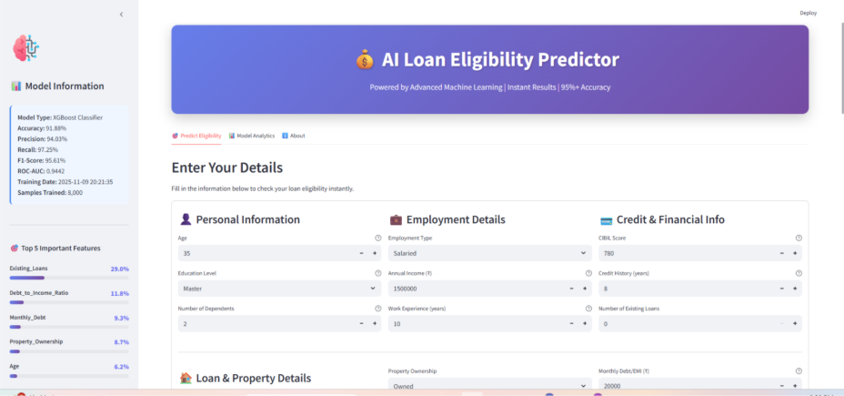

Slide 14
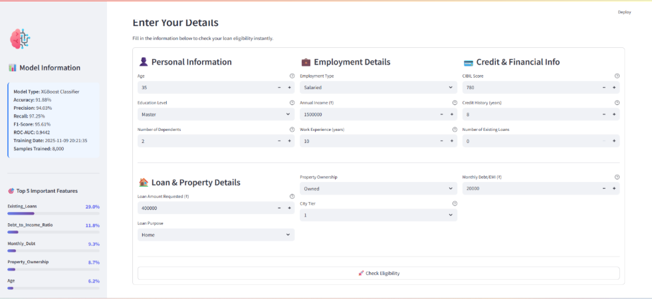

Slide 15
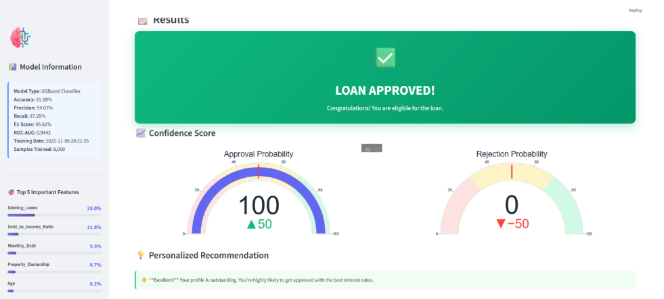

Slide 16
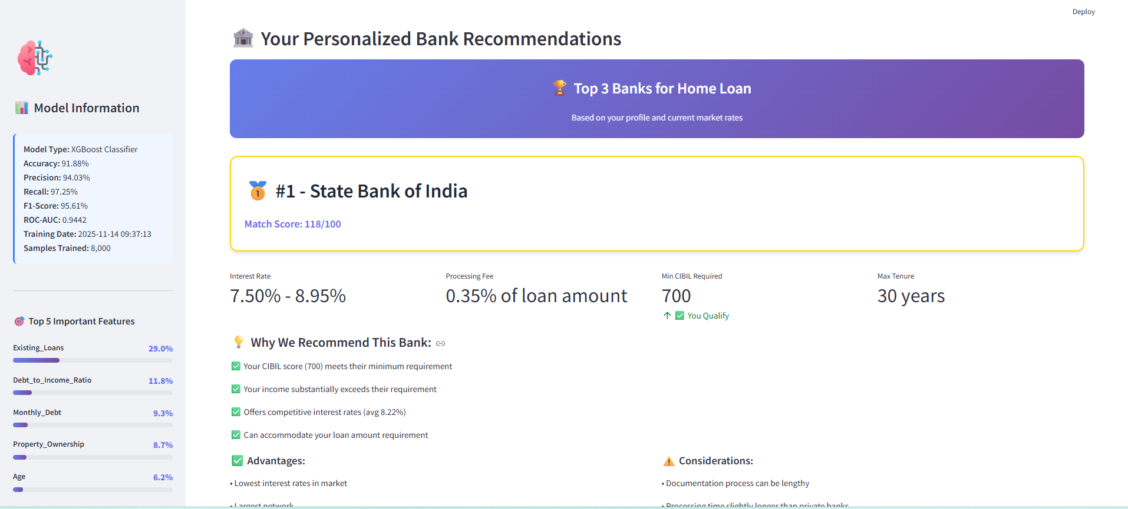

Slide 17
Challenges And Solutions
Data Scarcity and Quality Challenge: Lack of access to extensive real-world loan datasets and presence of missing or inconsistent data. Solution: Generated a large synthetic dataset simulating realistic loan applicant profiles. Applied rigorous data preprocessing techniques including handling missing values, encoding categorical variables, and feature scaling to ensure data quality.
Model Selection and Optimization Challenge: Identifying an accurate and reliable model for binary loan eligibility classification. Solution: Compared multiple machine learning algorithms including Logistic Regression, Decision Trees, Random Forest, and XGBoost. Selected XGBoost for its superior accuracy and regularization capabilities. Fine-tuned hyperparameters via GridSearchCV and cross-validation to optimize performance.
Integration and Deployment Challenge: Seamlessly integrating the complex trained model into an interactive user interface. Solution: Developed a Streamlit application that loads trained models and preprocessing objects, accepting user inputs and providing real-time eligibility predictions and bank offer recommendations with dynamic visualizations.
Handling No-Match Scenarios in Recommendations Challenge: Sometimes filtered bank offers fail to meet user criteria, resulting in empty recommendations. Solution: Implemented user input validation, fallback messaging, and ensured filtering logic matches realistic salary and loan amount ranges from the bank offers data.
User Experience and Interpretability Challenge: Conveying model outputs and recommendations transparently and understandably to users. Solution: Added interpretable analytics with feature importance charts, confidence scores, and clear explanations in the application dashboard to build trust and clarity.

Slide 18

Conclusion And Future Scope

Slide 19
Conclusion And Future Scope
The internship successfully developed a robust AI-based loan eligibility prediction system using XGBoost and extensive feature engineering.
The model achieved high accuracy (~91.88%) with excellent precision, recall, and ROC-AUC scores, showcasing its practical viability in financial decision-making.
The work provided deep exposure to the end-to-end ML lifecycle: from synthetic data generation, preprocessing, tuning, and evaluation to deploying an interactive Streamlit application.
The internship enhanced technical skills in Python programming, machine learning frameworks, model optimization, and full-stack integration, also fostering teamwork and problem-solving abilities.

Slide 20
Future Scope
Integrate real-world banking datasets to validate and improve model generalizability.
Develop mobile apps and REST APIs to deliver real-time loan eligibility checks at scale.
Incorporate Explainable AI techniques like SHAP or LIME to improve model transparency and regulatory compliance.
Expand to advanced risk modeling—predicting credit risk grades and default probabilities, leveraging more diverse data sources.
Enable continuous learning pipelines to keep the model updated with new data dynamically.
Automate the training, testing, and deployment with CI/CD pipelines and cloud/containerized environments for production readiness.
Extend to mobile platforms with Flutter or React Native for enhanced user accessibility and engagement.

Slide 21
References
[1] A. Alagic et al., "Machine Learning for an Enhanced Credit Risk Analysis: A Comparative Study of Loan Approval Prediction Models Integrating Mental Health Data," Mach. Learn. Knowl. Extr., vol. 6, no. 1, pp. 53-77, 2024, doi: 10.3390/make6010004
[2] A. Kulothungan, N. b, H. c, and K. Gupta, "Loan Forecast by Using Machine Learning," Turkish J. Comput. Math. Educ., vol. 12, no. 7, pp. 894–900, 2021.
[3] M. Madaan et al., "Loan default prediction using decision trees and random forest: A comparative study," IOP Conf. Ser.: Mater. Sci. Eng., vol. 1022, no. 1, p. 012042, 2021, doi: 10.1088/1757-899X/1022/1/012042.
[4] N. A. Azeez and A. O. Emmanuel, "LOAN APPROVAL PREDICTION BASED ON MACHINE LEARNING APPROACH," FUDMA J. Sci., vol. 6, no. 3, pp. 41–50, 2022, doi: 10.33003/fjs-2022-0603-830.
[5] I. Emmanuel, Y. Sun, and Z. Wang, “A machine learning-based credit risk prediction engine system using a stacked classifier and a filter-based feature selection method,” J. Big Data, vol. 11, 2024, no. 1, Art. 23, doi: 10.1186/s40537-024-00882-0.
[6] M. Patel, P. Bhardwaj, and Y. Arora, “Credit risk prediction using machine learning and deep learning,” Risks, vol. 12, no. 11, p. 174, 2024, doi: 10.3390/risks12110174.

Slide 22
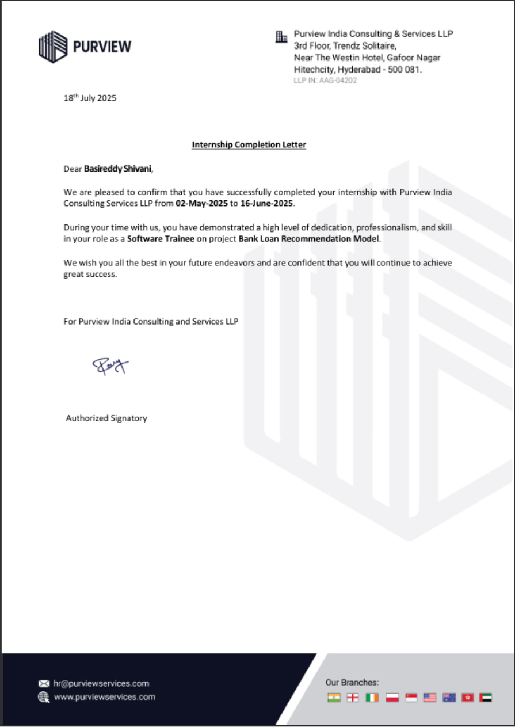
Internship Certificate

